Slide 1
Allstate Claims Severity
Kaggle Competition by Annie George

Slide 2
Introduction
Allstate wants to develop automated methods of predicting the cost, and hence severity, of claims and claim service

Slide 3
Exploratory Data Analysis
Data provided has no comprehensible variable name but has 116 categorical variables and 15 continuous variables including the response variable loss
No null values in the training or test data provided
Response variable is a continuous variable – loss. Hence the models that follow will be based on regression analysis

Slide 4
Exploratory Data Analysis (contd.)
Training data is split 80/20 and cross validated
Dummy variables are created for the categorical variables
Data is scale and centered

Slide 5
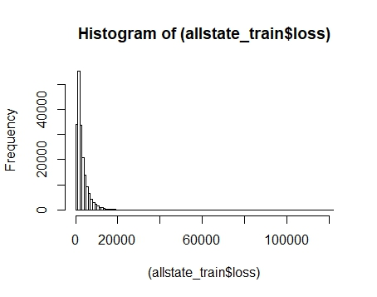
a. Histogram with no transformation
Right skew for response variable loss

Slide 6
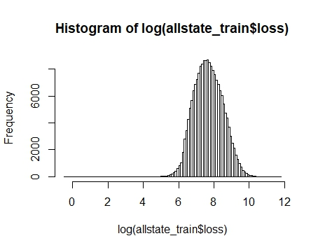
b. Histogram with log transformation
Using log transformation, the histogram has a Normal distribution.

Slide 7
c. ANOVA test for categorical predictors
Residual standard error = 2005.224
Only 4 variables - cat58, cat62, cat64, cat68 - have p-value greater than 0.05
Check if each model has these variables listed in variable importance.

Slide 8
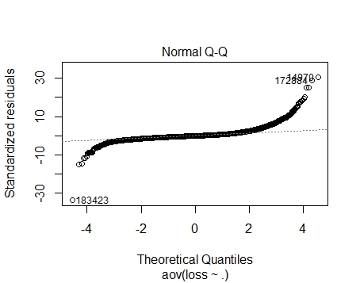
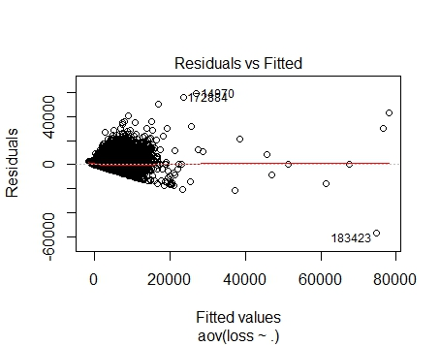
QQ plot and residual vs fitted plot for categorical predictors

Slide 9
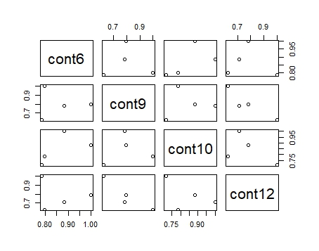
d. Correlation of numerical predictors
Correlated variables
- Strong correlation for the following variables (using correlation and not actual data
cont6, cont12, cont 6, cont 9

Slide 10
Feature Engineering
a. Forward Selection
Important variables (graph)
RMSE of training data = 0.8267
forward_model$bestTune
nvmax
18 20
Mean absolute error for test data using Kaggle submission = 3019.94

Slide 11
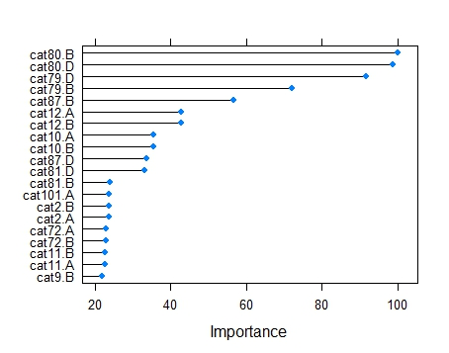
Variable importance using Forward Selection model

Slide 12
Feature Engineering
b. Lasso and ridge regression
Important variables (graph)
RMSE of training data = 0.7157
glmnet_model$bestTune
alpha lambda
55 0.5 0.0001676833
Mean absolute error for test data using Kaggle submission = 3020.36

Slide 13
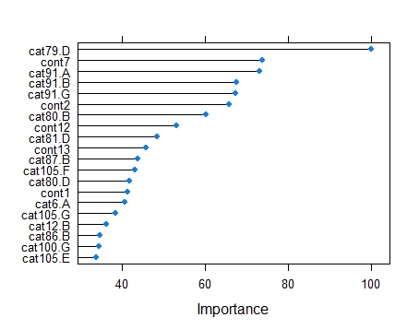
Variable importance using Lasso and Ridge model

Slide 14
Models
a. Multiple linear regression
Important variables (graph)
Interpretation of variance
Adjusted R square is 0.4574 which is low indicating high variance in the data using this model
RMSE of training data = 0.7165
Mean absolute error for training data = 21908.73
Mean absolute error for test data using Kaggle submission = 3021.32

Slide 15
Models
b. Decision Tree (with cp parameter)
Parameters
Complexity parameter with values 0.005, 0.002, 0.008
Important variables (graph)
RMSE of training data
CP RMSE R squared
0.002 0.7840 0.3913 ← Best model
0.005 0.8080 0.3534
0.008 0.8137 0.3443
RMSE of test data = 1.17 (too high)
Mean absolute error for test data using Kaggle submission = 3019.19

Slide 16
Models
c. Decision Tree (with depth parameter)
Parameters
Depth values 5, 10, 15, 20
Important variables (graph)
RMSE of training data
Depth RMSE R squared
5 0.8262 0.3071← Best model
10 0.8120 0.3307
15 0.8120 0.3307
20 0.8120 0.3307
RMSE of test data = 0.7937
Mean absolute error for test data using Kaggle submission = 3019.88

Slide 17
Models
d. Extreme Gradient boosting
Important variables (graph)
RMSE of training data = 0.667
xg_model$bestTune
nrounds max_depth eta gamma colsample_bytree
45 150 3 0.3 0 0.6
min_child_weight subsample
45 1 1
Mean absolute error for test data using Kaggle submission = 3020.15

Slide 18
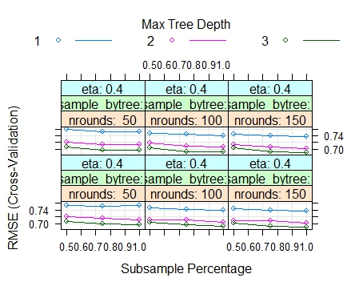
RMSE vs tree depth for extreme boosting

Slide 19
Conclusion
Comparing all models above Decision tree with complexity parameter yielded the lowest MAE.
However it would inappropriate to say that this is the best model.
Given more time, more models like SVM and random forest can be done or the above models with more parameters can be run.
Can also perform more feature engineering

